Slide 1

Secondary markets
KYC and Account Opening in Securities Market

Slide 2

Disclaimer
Information contained in this presentation is as on September 30, 2022.
The information contained in this presentation is only for Educational and Awareness Purposes related to securities market .
This presentation is only for Educational and Investor Awareness Programs and shall not be used for any legal interpretations.
SEBI or Stock Exchanges or Depositories shall not be responsible for any damage or loss to any one of any manner from use of this material.
Suggestions or feedbacks, if any, may please be sent by mail to visitsebi@sebi.gov.in.
2

Slide 3
Pre-requisites for buying/ selling shares in Securities market
Accounts needed to trade in securities market
Savings Bank Account
- Savings Account can be in any bank
- Transfer/ receipt of funds from buying/ selling of securities
Demat Account
- With a SEBI registered Depository Participant (DP)
- To hold shares in Demat (electronic) mode
Trading Account
- With SEBI registered Stock Broker( Trading Member/ TM)
- To buy/ sell securities
3

Slide 4
Forms to be Filled to open a new
Trading & Demat Account
A new investor has to register with a Stock Broker through whom the trades are executed on the Exchange.
The investor needs to fill two forms for Opening of Trading & Demat Account :
  Know Your Client (KYC) Form: To provide basic information of the new investor. Two modes for KYC are :
    Physical KYC
    e-KYC (online KYC)
  Account Opening Form: Details of various services and charges being applied on the new investor.
4

Slide 5
Trading / Demat Account Opening Form
Documents to open Trading / Demat account:
PAN Card: Mandatory Document & also Proof of Identity.
Same document like Driving License/ Passport.
PROOF OF IDENTITY
Permanent Account Number (PAN) Card – Mandatory
Voter ID Card
Driving License
Passport
Aadhaar Card
Any other valid identity card issued by Central or State Government
PROOF OF ADDRESS
Voter ID Card
Driving License
Passport
Ration Card
Aadhaar Card
Bank account statement or bank passbook
Utility bills, e.g. electricity bill or gas bill.
5

Slide 6
Trading/ Demat Account Opening Form
Documents to open Trading/ Demat account:
If investor is unable to produce the originals of these documents for verification, he may submit self-attested photocopies.
Proof of Income (for investors who chose to trade in Derivatives – F&O/ Commodities/ Currency) | Proof of Bank Account (any one)
Bank account statement for last 6 months | Cancelled Cheque (with name of investor above sign here section)
Latest Salary Slips/ Form 16 in case of salaried person | Bank Passbook {with Indian Financial System Code (IFSC)}
Copy of ITR Acknowledgement
Passport
Copy of Net-worth Certificate issued by a Chartered Accountant
Statement of Demat holdings
6

Slide 7
Officially Valid Documents (OVD)
S.No. | Officially Valid Documents (OVD)
1. | Passport
2. | Driving License
3. | Proof of possession of Aadhaar Number
4. | Voter’s Identity Card
5. | Job card issued by MGNREGA duly signed by an officer of the State Government
6. | Letter issued by the National Population Register containing details of name, address
7. | Any other document as notified by the Central Government in consultation with SEBI
In case OVD furnished by the investor does not contain updated address, then certain deemed OVDs (like Electricity Bill, Property Tax receipt, etc.) for the limited purpose of proof of address may be submitted.
7

Slide 8
Deemed - Officially Valid Documents (OVD)
If OVD furnished by the investor does not contain updated address, then following documents/ equivalent e-documents shall be deemed to be OVDs (only as proof of address):
S.No. | Deemed Officially Valid Documents (OVD)
1. | Utility Bill , not more than two months old of any service provider (electricity, telephone, post-paid mobile phone, piped gas, water bill)
2. | Property or Municipal tax receipt
3. | Pension or family pension payment orders (PPOs), if they contain the address
4. | Letter of allotment of accommodation from employer issued by Government departments, statutory or regulatory bodies, PSUs, etc.
Investors submitting above mentioned documents as proof of address shall submit OVD with current address within a period of 3 months of submitting the above documents.
8

Slide 9
Documents in Account Opening Forms
- Trading & Demat Account
Account Opening Form has two type of documents :
**(to be submitted only if investor is availing of additional services)
MANDATORY DOCUMENTS
Rights & Obligations of Stock Broker and Investor.
Uniform Risk Disclosure Documents.
Do’s and Don’ts for trading on Exchanges.
Policies and Procedures of Stock Broker.
Tariff Sheet.
VOLUNTARY DOCUMENTS**
Running Account Authorization.
Power of Attorney (PoA).
Demand Debit and Pledge Instruction (DDPI).
Electronic Contract Note (ECN) Declaration.
Consent for electronic communication and receiving alerts (Email/ SMS).
9

Slide 10
Nomination for Trading/Demat/Mutual Fund Units
Investor to get two options regarding nomination
  To provide nomination in the prescribed form up to three person along with their percentage
  Opting out of nomination through prescribed declaration form
Folios/Account to be freezed if none is opted till March 31, 2023
Applicable for opening new Demat account and trading accounts on or after October 01, 2021
Applicable for investor subscribing to mutual fund units on or after October 01, 2022.
For existing unit holder, AMC shall provide an option to submit
  In case of physical option, the form shall carry the wet signature
  In case of online option, AMC shall validate the form using e-Sign Or through two factor authentication (2FA)
10

Slide 11
Power of Attorney (PoA)
Power of Attorney (PoA) is Optional and should not be insisted upon for opening of the client account.
PoA executed in favour of a Stock Broker by the client should limited to the following:
  Transfer of fund of client for settlement obligation
  Enable stock broker and depository participants to operate bank account to meet settlement obligations
A valid PoA must be 'franked' (i.e stamped).
This is applicable with effect from September 18, 2022.
11

Slide 12
Demat, Debit and Pledge Instruction(DDPI)
To safeguard the interests of investors, a new document called - Demat, Debit and Pledge Instruction (DDPI).
DDPI limited for following purposes only:
          To transfer securities held in your account towards stock exchange related deliveries or settlement obligations
  To pledge/re-pledge securities
  Mutual fund transactions being executed on stock exchange order entry platforms (shall be in compliance with SEBI circulars)
  Tendering shares in open offers (shall be in compliance with SEBI circulars)
  Came into effect from November 18, 2022
12

Slide 13
  SAMPLE
  KYC FORM AND ACCOUNT OPENING FORM
  (AOF)
13

Slide 14
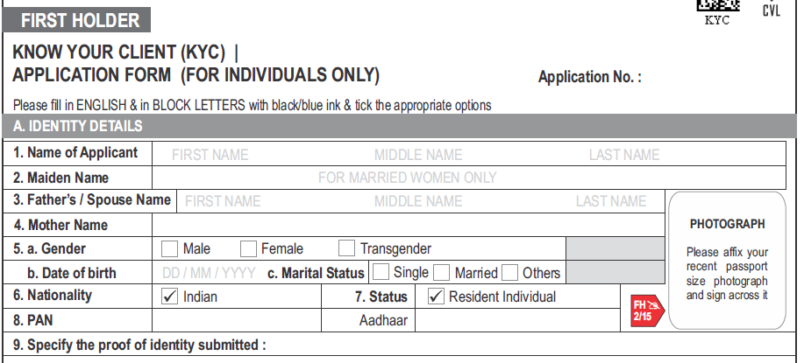
KYC : Identity Details
Identity details must exactly match the address mentioned in the documents submitted (e.g. Passport , Aadhaar Card, etc.)
13

Slide 15
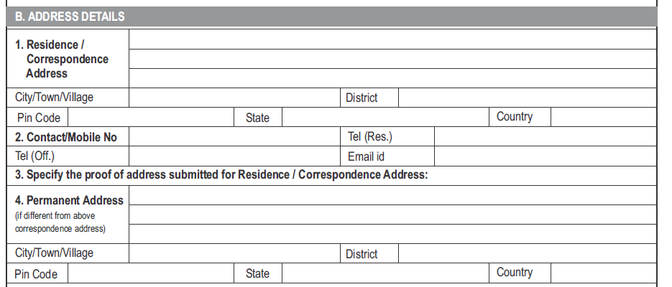
KYC : Address Details
Address must exactly match the address mentioned in the documents submitted (e.g. Passport, Aadhaar Card, etc.)
14

Slide 16
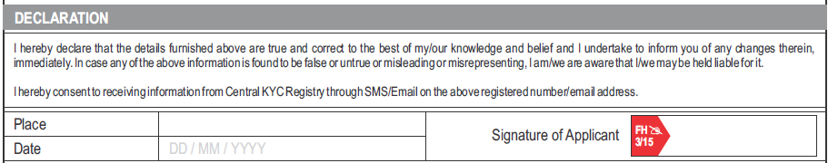
KYC : Declaration of Details
15

Slide 17
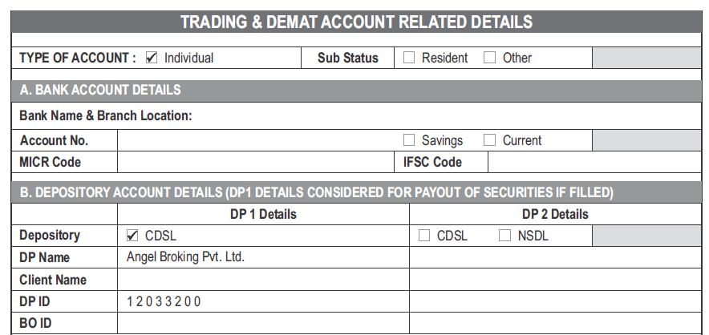
Sample AOF -
Trading and Demat A/C Details
Investor can inform Stock broker about choice of DP A/C for credit / debit of shares.
16

Slide 18
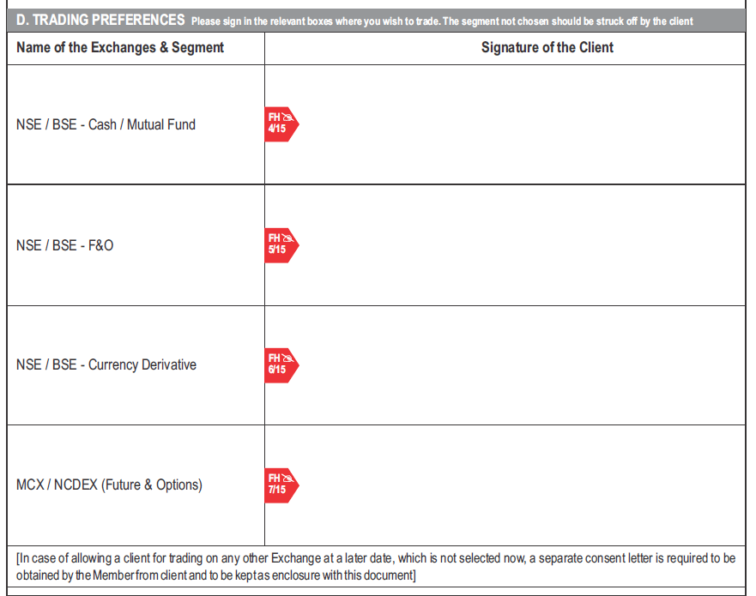
Sample AOF -
Selection of Market Segments
Investor can select the segments on which he would like to trade
(Cash / F&O / Currency Derivatives / Commodity Derivatives) and affix his signature against the selected segments.
17

Slide 19
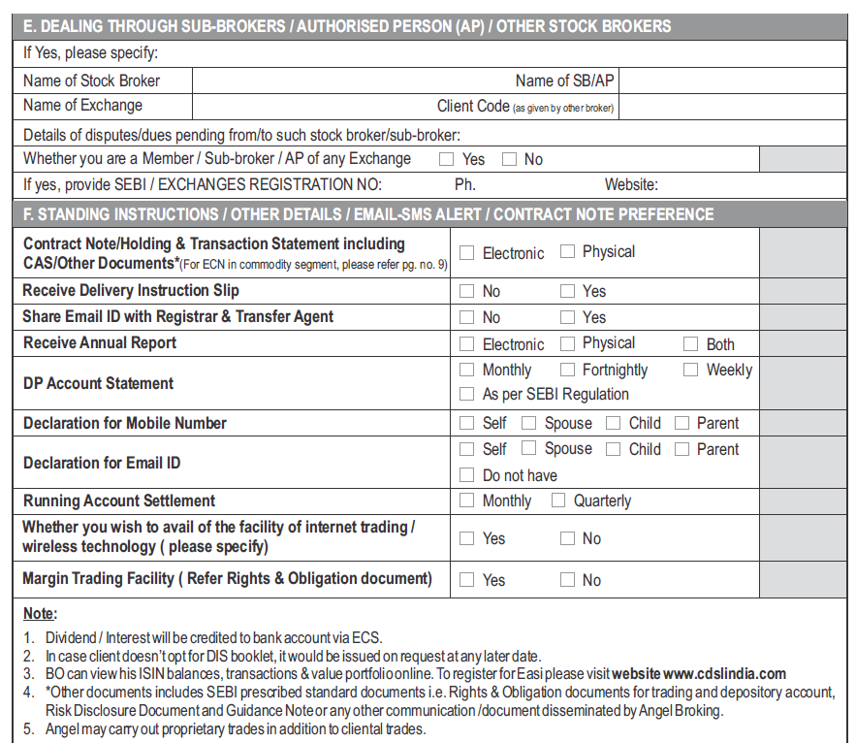
Sample AOF -
Authorized person/Standing Instructions/Alerts
Investor can choose on Standing Instruction, DIS, Email ID, etc.
18

Slide 20
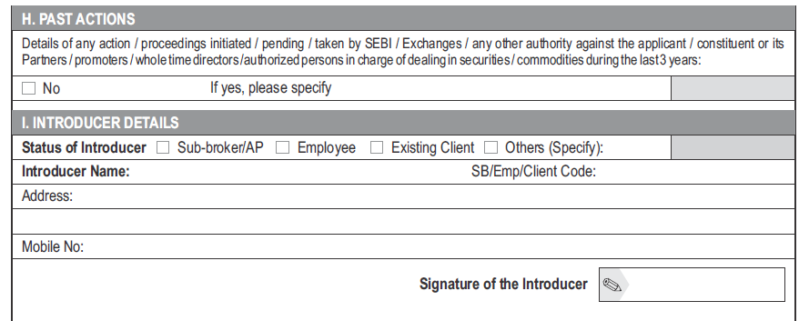
Sample AOF -
Past Actions & Introducer Details
Investor must disclose details of all past actions / proceedings.
In case, there is an introducer who introduced investor to the Stock Broker, his details may be provided.
19

Slide 21
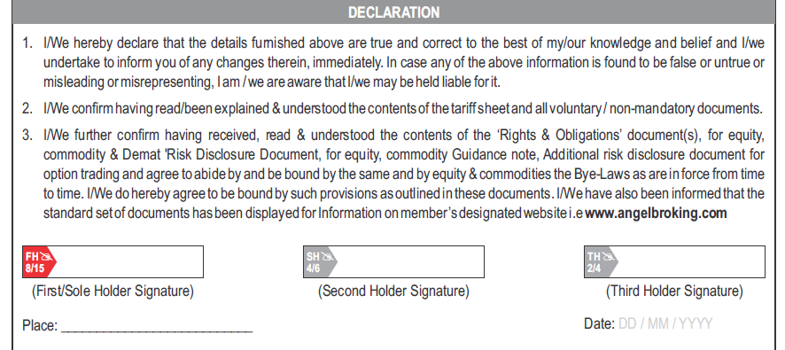
Sample AOF -
Declaration by investor
Investor should read all the documents provided to him with account opening forms and should always provide correct information while completing his/ her account opening process.
Investor should understand all the charges and tariffs applicable to him and after verifying and clarifying everything should only he submit the above mentioned declaration.
20

Slide 22
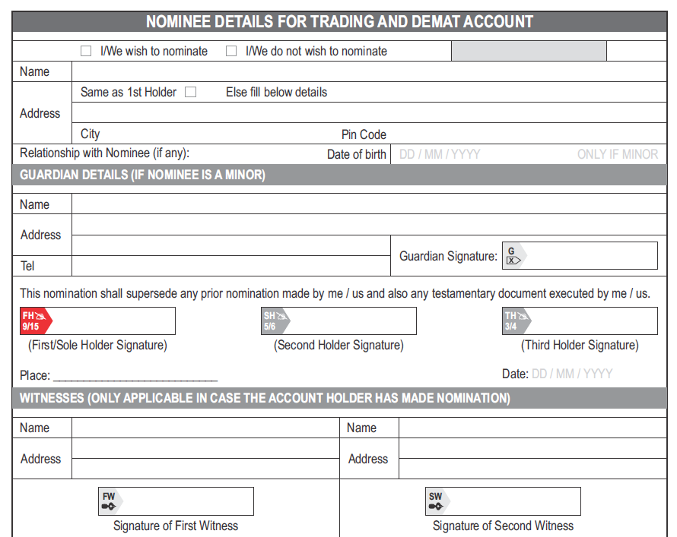
Sample AOF -
Nomination
Nomination: Facility that enables an individual investor to nominate a person, who can claim the securities held by him/ her in the unfortunate event of death of investor.
All investors should utilize the nomination facility in their accounts to safeguard their investments, in case of any unfortunate event.
21

Slide 23
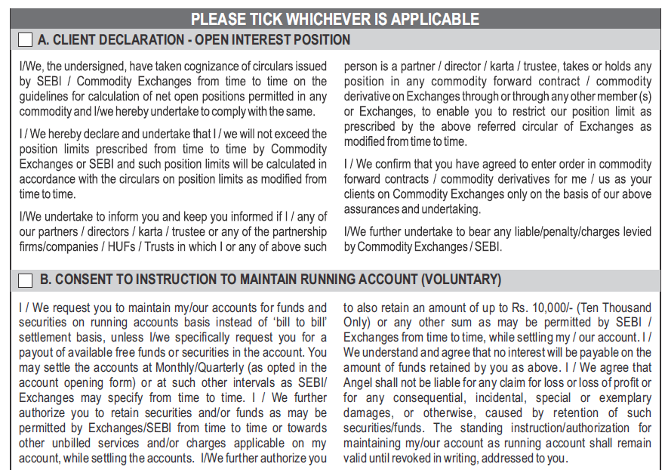
Sample AOF -
OI (F&O) / Running Account Declarations
Open Interest (OI) Position :
Number of contracts or positions outstanding in futures and options on an exchange.
Investor must comply with all Regulations, Circulars, Notices, etc., issued by SEBI and Stock Exchanges with regard to OI.
Running Account :
Settlement of funds and / or securities is done within one working day of the pay-out, unless client specifically authorizes the Stock Broker in writing to maintain a running account.
Clients whose funds and securities are maintained on a running account basis have to be settled by members on a monthly / quarterly basis as per the client mandate.
Members should ensure that there is a gap of maximum 30/ 90 days (as per the client mandate) between two running account settlements.
22

Slide 24
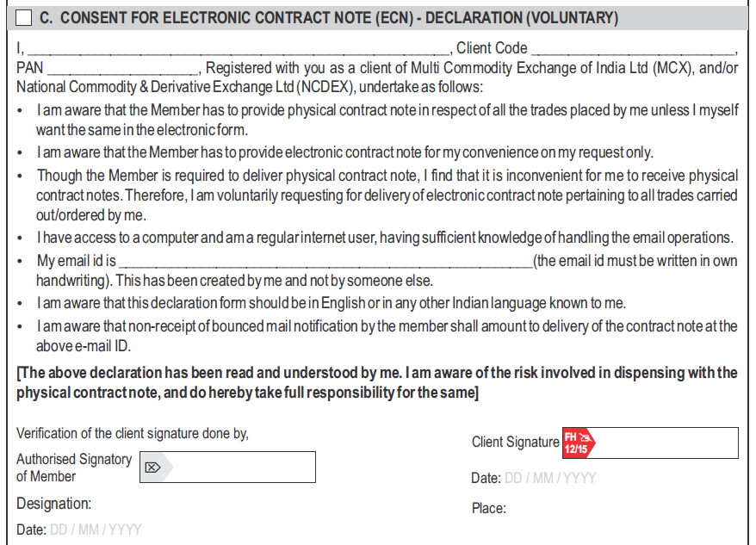
Sample AOF -
Consent for Electronic Contract Note (ECN)
Investor should opt for ECN only if comfortable with using email.
Contract Note is an evidence of the trade done by the stock broker.
It’s a legal document which contains details of the transaction such as securities bought/ sold, traded price, etc.
23

Slide 25
Sample AOF -
Power of Attorney (PoA)
Gives authority to Stock Broker to debit shares from Demat account of the client.
3-in-1 account- PoA:
  Sell Trades : Authorization to debit shares from Demat account.
  Buy Trade : Authorization to debit linked Bank account (when investor adds funds to his trading account i.e. for payment of margin / payout of funds of purchase of shares).
A valid PoA must be 'franked' (i.e stamped).
Investor must send the printed copy of the filled PoA form to the Stock Broker.
Investor may also give his consent to a temporary PoA at the time of login to his trading account → This is valid only during that particular login session.
Alternative Mode:
  Transfer funds to Designated Account of Stock broker via Cheque / Online Fund transfer.
  Place delivery sell instructions by using the physical DIS slip / TPIN E-DIS (CDSL) / SPEED-e (NSDL)
24

Slide 26
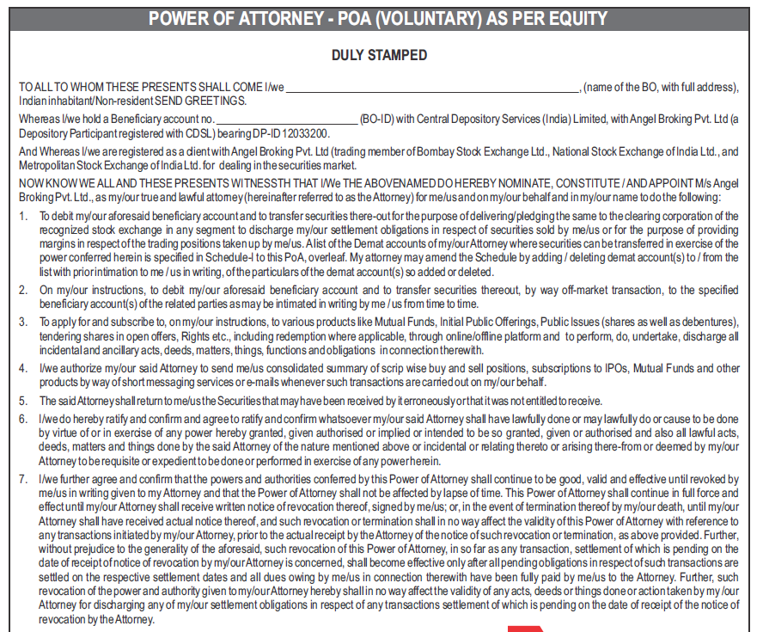
Sample AOF -
Power of Attorney
Power of Attorney:
Gives the broker the right to handle client’s shares.
An optional document.
Should not be insisted upon by the stockbroker/ depository participant (DP) for opening of the client’s account.
Margin obligations to be given in the form of securities by investors will be by way of pledge or re-pledge in the depository system.
Not to be considered as equivalent to the collection of margin by the Broker in respect of securities held in the demat account.
25

Slide 27
Sample AOF -
Brokerage Plans for Trading Account
Plans/ Charges | Details
Account Opening and Maintenance Charges (*Some stock brokers may waive off this charge) | Account opening fees. Annual Maintenance Charges.
Postpaid Plans | Fixed % charge per trade (Maximum 0.25% of Trade Value). Trading volume based brokerage. - High brokerage for low volume trade. - Low brokerage for high volume trade.
Prepaid Plans | Upfront amount to be paid. Subsequently, a reduced Fixed % charge per trade is charged (as compared to postpaid plans).
Postpaid Plans | Fixed % charge per trade (maximum 0.25% of trade value)
Charges may vary based on segment = Equity/ Derivatives/ Mutual Funds, etc.
26

Slide 28
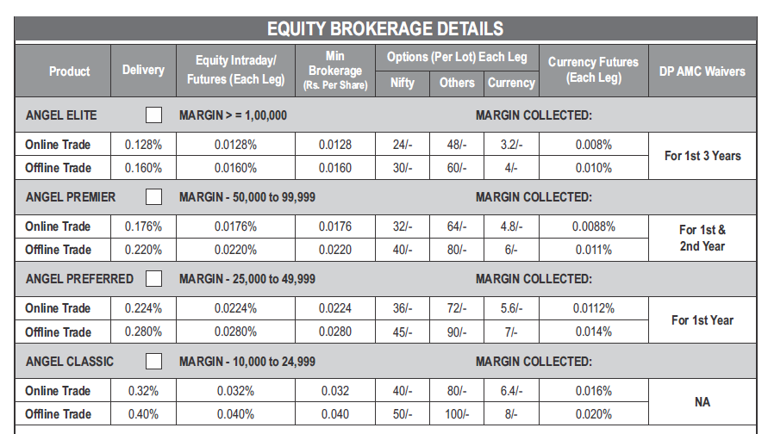
Sample AOF -
Select Brokerage Plans
PLAN 1
PLAN 2
PLAN 3
PLAN 4
27

Slide 29
Sample AOF -
Charges for Demat Account
Plans/ Charges | Details
Opening Charges (*Some DPs may waive off this charge) | Charged by Depository Participant (DP) for opening new Demat Account.
Annual Maintenance Charges (AMC) | Usually Paid in advance. DPs may offer Quarterly/ Annual/ Lifetime plans, etc.
Transaction Charges (*Some DPs may charge NIL amount for Credit Transactions) | Dematerialization/ Rematerialization. Transaction Charges: Per sell trade (debit)/ per buy trade (credit)**. Pledge Charges/ Invocation of Pledge. Reissuance of DIS Slip Booklet. Charges of CAS.
28

Slide 30
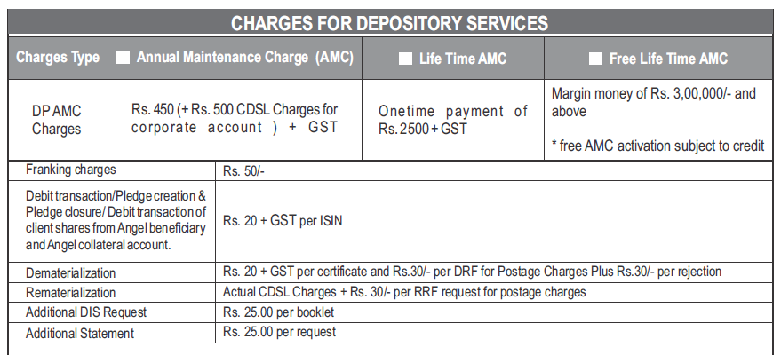
Sample AOF -
Demat Account Plans
Depository participants may offer different plans based on volumes, time period, etc.
29

Slide 31
Basic Services Demat Account (BSDA)
Facility for retail investors
Eg: Debt securities = Rs.90,000/- & Equity Shares = Rs.40,000/- → NO AMC Charge.
Eg: Equity shares = Rs.1 lakh & Value of those shares increases to Rs 2.5 lakhs → Investor is not eligible for BSDA.
EQUITY SHARES |  | DEBT SECURITIES
Holding | AMC Charges | Holding | AMC Charges
<Rs.50,000 | NIL | <Rs.1,00,000 | NIL
Between Rs.50,000/- – Rs.2,00,000/- | Rs.100/- per year | Between Rs.1,00,000/- – Rs.2,00,000/- | Rs.100/- per year
>Rs.2,00,000/- | Charges as applicable to regular (non-BSDA) accounts | >Rs.2,00,000/- | Charges as applicable to regular (non-BSDA) accounts
30

Slide 32
SARAL Account
For Clients who:
  Begin with participation in the cash segment.
  Without obtaining various other facilities such as internet trading, margin trading, derivative trading and use of power of attorney (PoA).
SARAL form contains:
  Basic information of the investor such as:
    Address.
    Bank account details.
    Email Id.
    Mobile no.
31

Slide 33
In-Person Verification (IPV)
Compulsory for opening trading/ demat account.
It can be done through physical verification/ online verification using webcam at the Stock Broker’s office.
In case of e-KYC, Video In Person Verification (VIPV) for Individuals is also available.
In-person verification of the client is not required to be carried out, if:
  KYC of the investor is completed using the Aadhaar authentication/ verification of UIDAI.
  KYC form has been submitted online, documents have been provided through DigiLocker or any other source which could be verified online.
32

Slide 34
e-KYC
33

Slide 35
e-KYC Process - Outline
Fill the account opening details/ form online in the Stock Broker’s website.
Submit scanned images of the mandatory documents/ POA (Proof of address) / POI(Proof of Identity).
Complete IPV (In Person Verification) process over video call.
Account gets activated.
Digitally Sign the document.
34

Slide 36
Benefits of e-KYC
Benefits of e-KYC
No need to visit the Stock Broker’s office
Convenient Registration and Paperless Process
Easy Retrieval of KYC Documents
Digital Authentication
Quickly start investing
Time Saving
35

Slide 37
e-KYC Process
Process Outline:
Verification :
Mobile and Email → through One Time Password (OTP)
Aadhaar → through UIDAI’s authentication/ verification mechanism
PAN → through Income Tax Database
Bank account details → by initiating small transfer (usually Re.1/-) which would provide details on name of account holder, bank and IFSC code, also called Penny Drop Mechanism.
Documents other than Aadhaar → through Digilocker/ e-Sign mechanism
Visit Website/ App/ Digital platform of Stock Broker
Fill online KYC Form
Submit documents online as photograph/ scan of original documents, under e-Sign
36

Slide 38
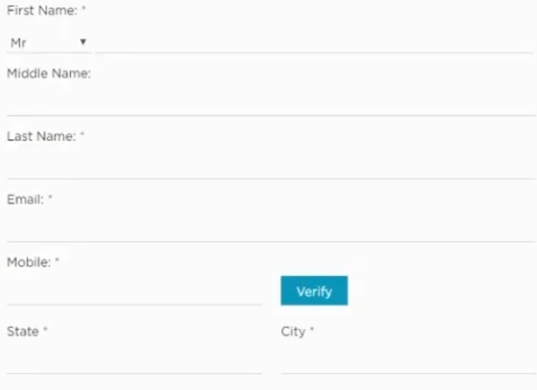
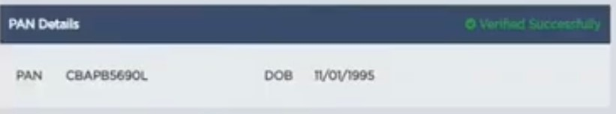
e-KYC Process
(Basic Details)
Mobile number verified via OTP
PAN Verified from Income Tax (IT) Database.
37

Slide 39
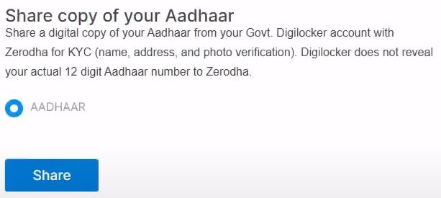
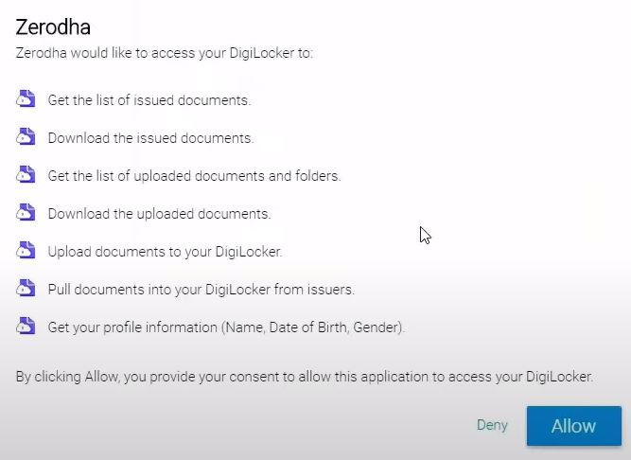
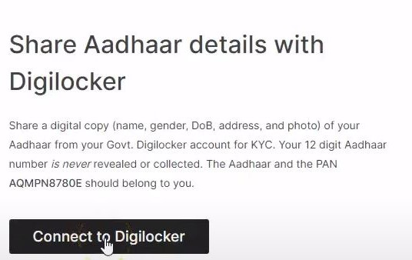
e-KYC Process
(Link to documents via Aadhaar / Digi Locker)
Investor can do KYC via Aadhaar Linkage of e-Sign (described in subsequent slides).
38

Slide 40
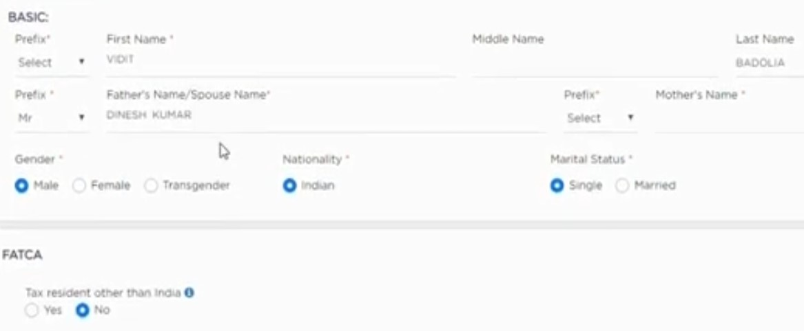
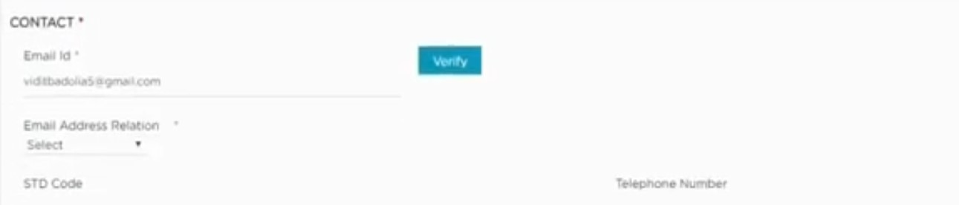
e-KYC Process
(Basic Information & Email ID verification)
39

Slide 41
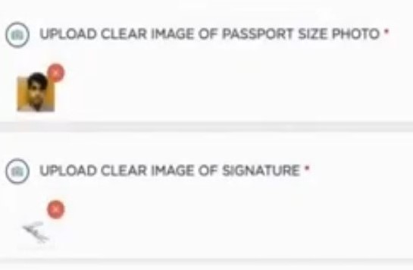

e-KYC Process
(Upload Photo and Signature)
Investor has the option of taking print out of this form, attach their Photograph, affix their signature and send the filled form to the Stock Broker’s Address.
40

Slide 42
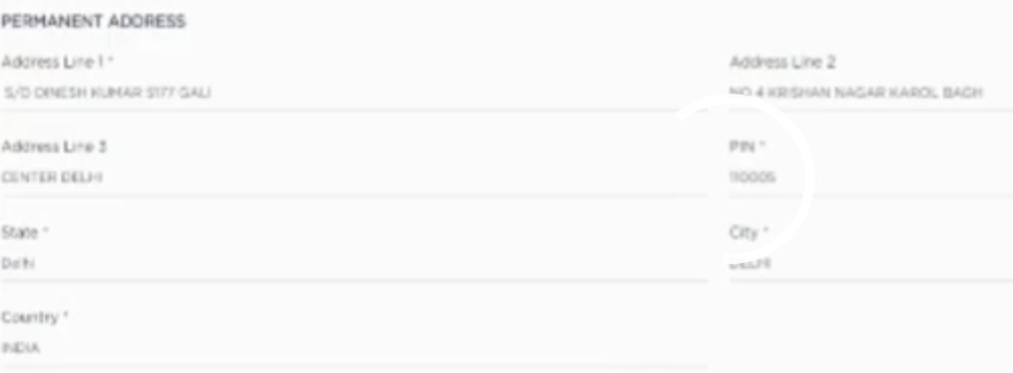
e-KYC Process
(Basic Information & Email ID verification)
41

Slide 43
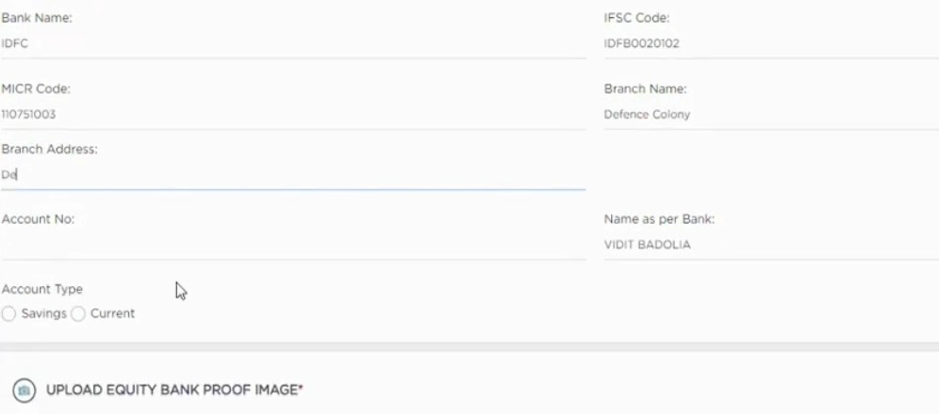
e-KYC Process
(Bank Account Details)
Documents allowed :
Latest Income Tax Return
Bank Statement
Salary Slip
Demat Account Holding by value
42

Slide 44
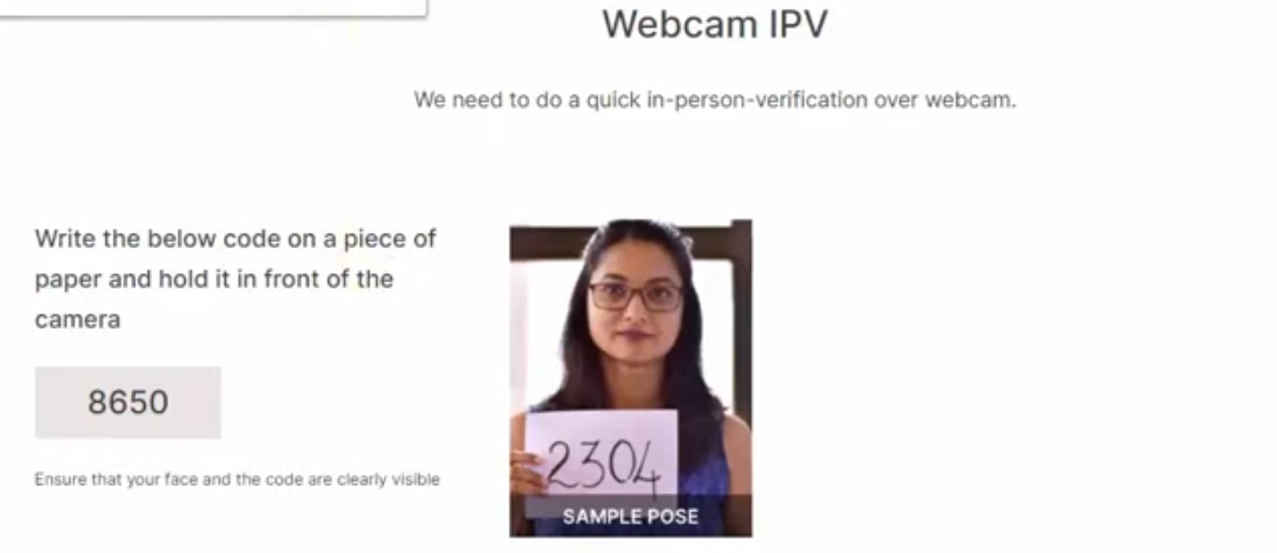
e-KYC Process
{Video In Person verification (IPV)}
WEBCAM IPV
Representative of the Stock broker will complete the In Person verification process via Webcam which can be done through the website of the Stock broker or any other mode like WhatsApp.
43

Slide 45
e-KYC Process
{Video In Person verification (IPV)}
Stock Broker may take Video IPV (VIPV) subject to:–
Live VIPV after obtaining consent.
Video should be clear and still and investor should be easily recognisable.
To have random questions and responses from Investors including displaying documents, KYC form & signature or could also be confirmed by an OTP.
Stock broker to check if Photograph of the customer downloaded from Aadhaar authentication matches with the same in VIPV.
Stock Broker to digitally save a copy of this video in a safe, secure and tamper-proof database.
44

Slide 46
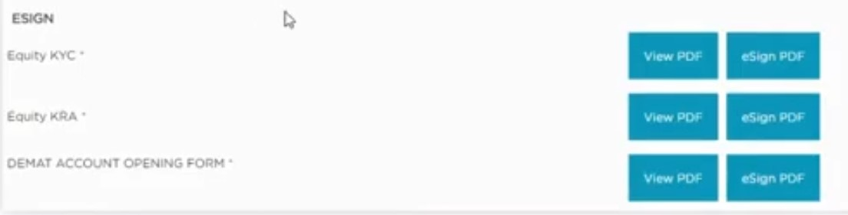
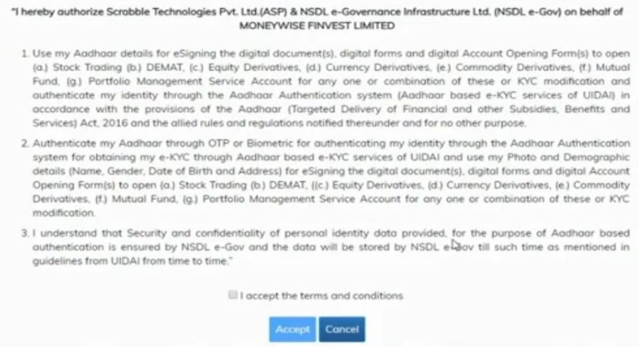
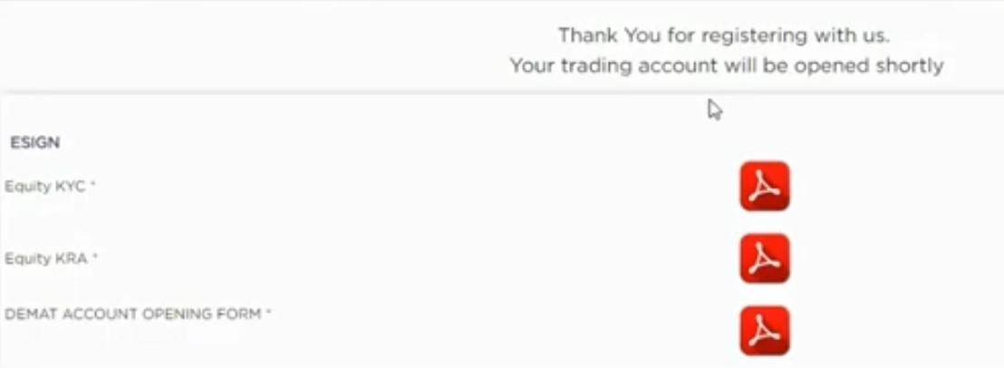
e-KYC Process
(E-Sign)
E-Sign: Facility that lets an individual, either submit the online KYC documents with image of their signature or option to investor to download and print the form, sign the printed form and then scan and submit the signed form on e-sign.
45

Slide 47
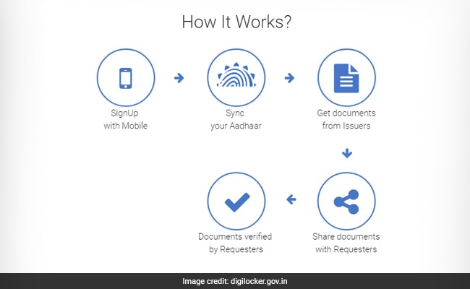
e-KYC Process
(Uploading Documents via DigiLocker)
Digital locker facility: https://digilocker.gov.in/.
Also available on various App Stores on Smartphones.
Allows easy storage and sharing of scanned/ digital formats of documents.
Accessed via Aadhaar Number / OTP on Linked Mobile Number.
User manual for DigiLocker: https://digilocker.gov.in/assets/img/DigiLocker-User-Manual.pdf
46

Slide 48
e-KYC Process
(Post Completion of Application)
Fill all information as per online KYC process.
Take a print out of completed KYC form, sign it and send the scanned copy/ photograph of the filled form to Stock broker under e-Sign.
OR
Affix online the cropped signature on filled KYC Form and submit same to Stock broker under e-Sign.
Stock Broker to send KYC completion intimation letter through registered post/ speed post or courier to the address of the investor.
47

Slide 49
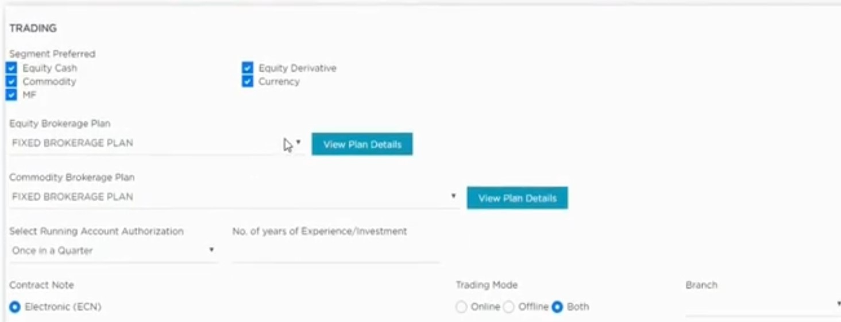
Brokerage Plan
Income Proof Document needs to be submitted for trading in Derivatives (F&O) segment.
Check if Stock broker offers Physical / Electronic Contract Note.
Select Mode of trading : Offline (visit to branch / Phone Call) / Offline (Website / App).
48

Slide 50
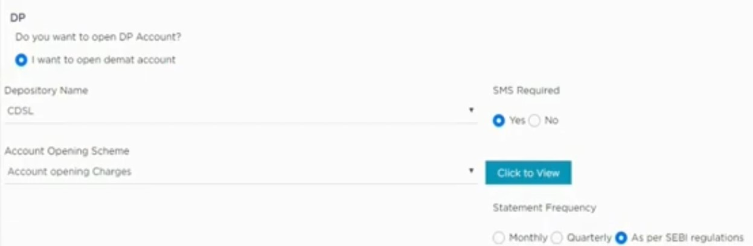
Demat Account Opening
In case investor wants to open only a Trading or only a DP A/C, he may contact the Stock Broker.
For SMS alerts.
Can vary as per plan offered by DP.
49

Slide 51
Contents of Welcome Kit for New Trading and Demat Account
Client Profile sheet (For Trading Account)
Trading Account number / Unique Client Code (UCC).
Password for Online Login
Used to trade, verify transactions, check account details.
User Name / CRN Customer Relationship Number (CRN).
Relationship Manager & Dealer’s details.
Stock Broker Branch address and designated phone number to place trades.
Linked (Registered) Bank & Demat account.
Brokerage applied on your trading account.
Contact details for lodging complaints and grievances.
Given in a sealed envelope.
Used to activate the Online account and update the password.
50

Slide 52
Contents of Welcome Kit for New Trading and Demat Account
Client master (For Trading Account)
Depository Account number.
Delivery Instruction Slip (DIS) Booklet
To transfer shares from one account to another by submitting duly filled printed copies of DIS to Branch of Stock broker and fulfilling all trade obligations.
Details of Nominee.
Correspondence address and contact details.
Linked (Registered) Bank account.
Brokerage addendum, if applicable.
Stock Broker may provide the Welcome Kit by Post/ Email.
51

Slide 53
Good Practices of a prudent investor
Deal only with SEBI registered intermediaries.
Do not give any blank documents to DP/ stock broker. Strike off the fields which are not filled.
Read carefully all the documents before signing.
Should not submit incomplete KYC documents to DP/ stock broker.
Provide correct email id & Mobile number for receiving timely alerts related to any transaction being carried out in your account.
52

Slide 54
Good Practices of a prudent investor
Make sure no email id is generated by the Stock Broker.
Do not share user Id and password details of your accounts with anyone.
Select the Segment and Stock Exchange on which you wish to trade.
Do not trade on any tip-offs / SMS / Emails / Assured Return Schemes.
Go through all the official SMS & Emails provided by the Stock Exchange and Stock Broker.
53

Slide 55
Good Practices of a prudent investor
Beware of unauthorized Stock Brokers.
Beware of Fixed / assured returns.
Don’t Trade on the basis of Hot investment tips or unsolicited investment advice giving assured/ unrealistic returns.
Keep a regular check of your running account and settle your account periodically.
Examine and review transactions and holding details in your trading and demat account periodically.
Transfer funds / securities only from registered Bank Account / Demat account.
Power of Attorney (PoA) is not Mandatory. Further, you can cancel your POA anytime.
Reference : https://www.bseindia.com/static/investors/services.aspx
https://www.nseindia.com/invest/first-time-investor-fraud-dos-and-donts
54

Slide 56
Points to remember for new investors
Read all documents in KYC carefully before signing.
Select the Segment and Stock Exchange on which you wish to trade by affixing your signature instead of a Tick mark or YES. Strike off which ever is not opted.
Sign on the Tariff Sheet.
Select / Unselect Online Trading Option.
Power of Attorney (PoA) should only be given to access your accounts to the extent of the obligation. No POA to be given to trade on your behalf.
Policies, Procedures, Brokerage Rates, Other Charges vary for every Stock Broker.
Investors have to sign only on one document while opening any account and are supposed to submit KYC documents only once.
Give your own email id/mobile number while submitting the KYC documents.
Please remember that no one can guarantee assured returns in the securities market.
55

Slide 57
Communications sent to
Investor from Exchange
Welcome email to new investors.
Free of charge SMS and email alerts for any trading/ transaction activity that would happen in their trading and demat account.
Monthly balances available with the Stock Broker:
  End of day fund balances.
  End of day securities balances.
  Details of securities pledged and funds raised.
56

Slide 58
Rights of a New Investor
A client should receive a copy of the signed KYC within 7 days.
Select type of account (Running Account / Bill to Bill).
Decide on the Stock Exchange and Segment in which you want to trade.
Decide in the shares/ derivatives/ mutual funds where you want to trade.
To receive user id and password and other credentials of the account, in cases where you have opted for Online trading.
57

Slide 59


Additional Information
For further information, you may visit the following web-sites and Mobile App:
  www.sebi.gov.in/
  https://investor.sebi.gov.in/
  Saa₹thi App
For Grievance Redressal, you may visit following website:
  www.scores.gov.in/
Or, you may call SEBI at following Toll-free Helpline Numbers from 9:00am to 6:00pm on all days (excluding declared holidays in the state of Maharashtra):
  1800 266 7575
  1800 22 7575
Helplines are available in 8 Languages:
English, Hindi, Bengali, Gujarati, Marathi, Kannada, Telugu and Tamil
SEBI : HAR INVESTOR KI TAAQAT
58

Slide 60
Thank You
59

